Slide 1
Motion Based Controller for a Humanoid Robot
K.L.S Akash –221910312015
K.S.P Vijay vardhan-221910312019
M.D.V Kashyap-22191312032
Sreekanth Reddy Syamala-221910312052

Slide 2
Introduction
As the modern-day technologies advances every day, the access to harmful environments grows exponentially.
The need for artificial remote controllers to manipulate an environment is paramount.
With controllers, the complexity for precise and accurate movement is high but using a Machine learning framework that can automatically detect the movement made by an individual and subsequently send the data to a robot which mimics the entire movement reducing the complexity for any precise and accurate movement desired by the user.
This project aims to simply control a robot by providing a motion-based system using multiple sensors and cameras.
This project also aims to fully control a robot including its arms and legs to completely emulate a human for the advancements of performing human actions in an environment that may or may not be suitable for human survival.

Slide 3

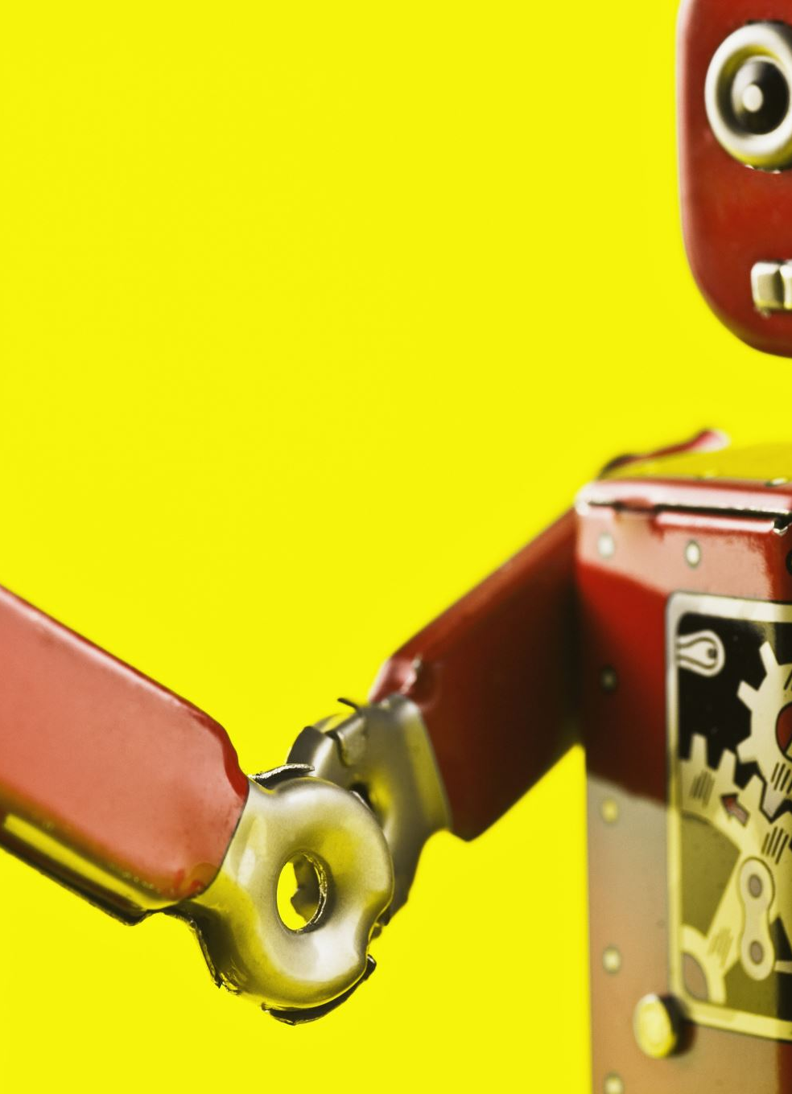
Problem Statement
The main issue being faced that this problem aims to solve is the controlling of a robot without the need of physical controllers to achieve accurate movements for the purpose of manipulating its environment

Slide 4
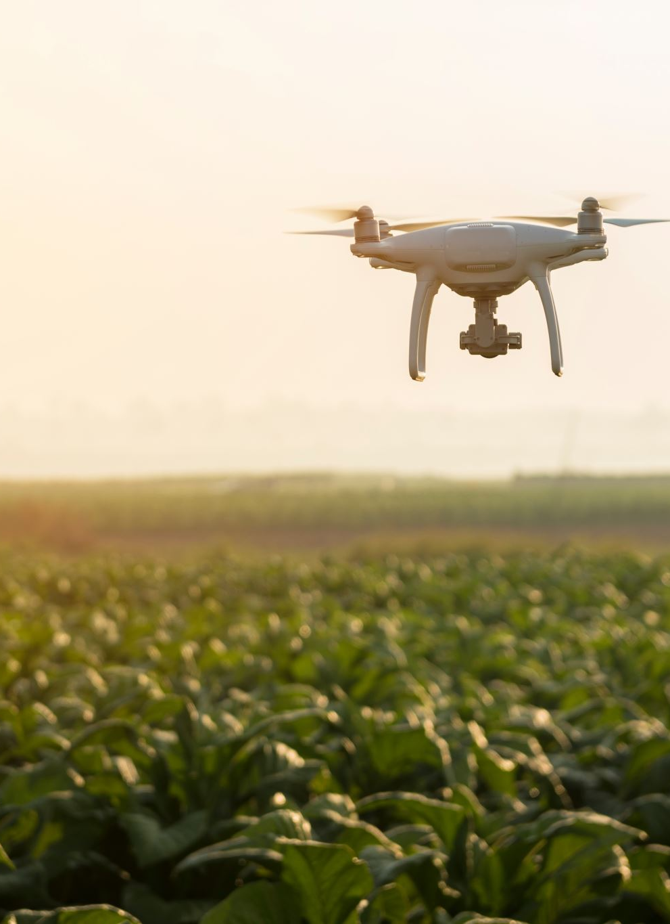
Existing Solutions
Drones: Drones are used to remotely manipulate their environment wirelessly but at the expense of a high production and maintenance costs.
Ex: Amazon delivery drones, Industrial farming drones

Slide 5
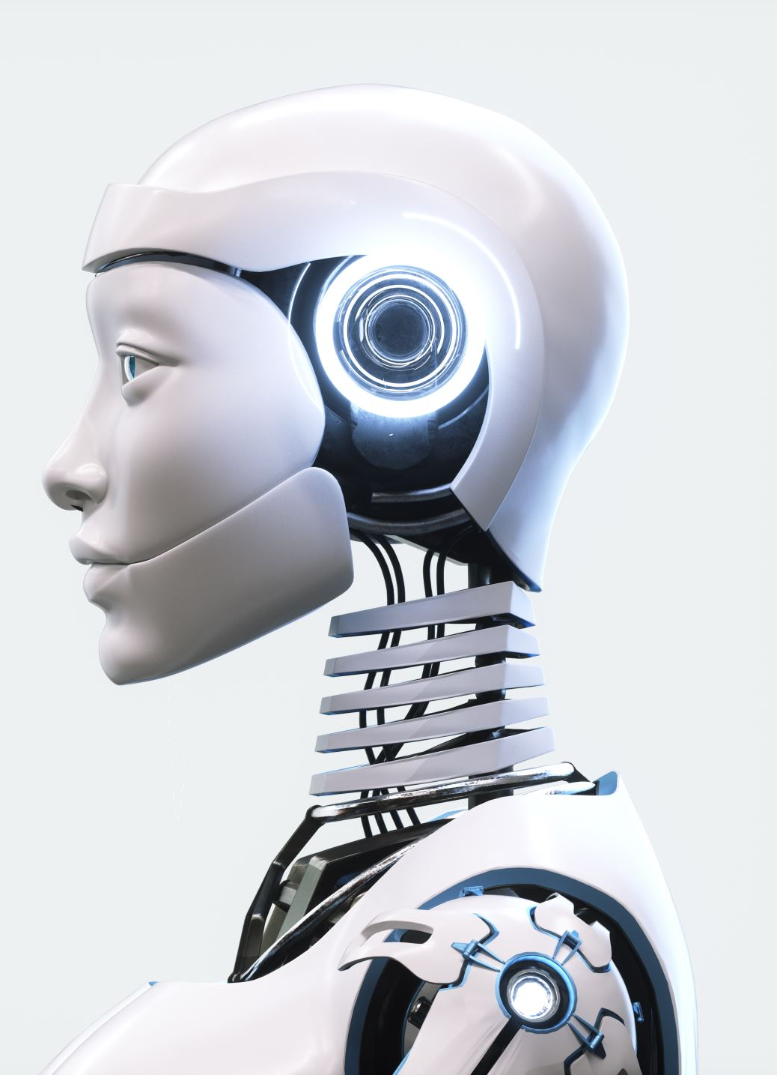
Existing Solutions
Logical Artificial Intelligence Models: AI learning models that are able to autonomously make decisions based on its goals, environment, and the inputs received from sensors but can get complicated and very expensive.
Ex: Humanoid robots made by Boston Dynamics

Slide 6

Existing Solutions
Machine Learning Models: ML models using a dataset to perform actions but at the cost of time complexity and the need for a massive amount of data
Ex: Captcha

Slide 7
Existing Solutions
Human Guided Controllers: Robots that are directly controlled by humans via controllers such as joysticks or commands. These may include the robots currently being used to control the rovers in extraterrestrial areas. They can often be inaccurate in precise movements to manipulate it's environment.
Ex: Mars Perseverance Rover

Slide 8
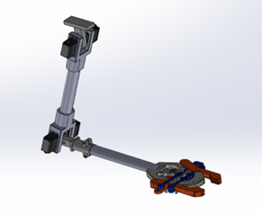
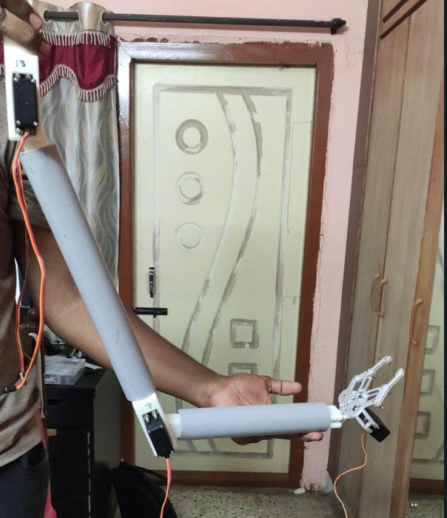
Previous Iteration
Arm Prototype:
The earlier prototype developed for the concept involves only a single 2 DOF robotic arm that is manipulated in a 2D space.

Slide 9
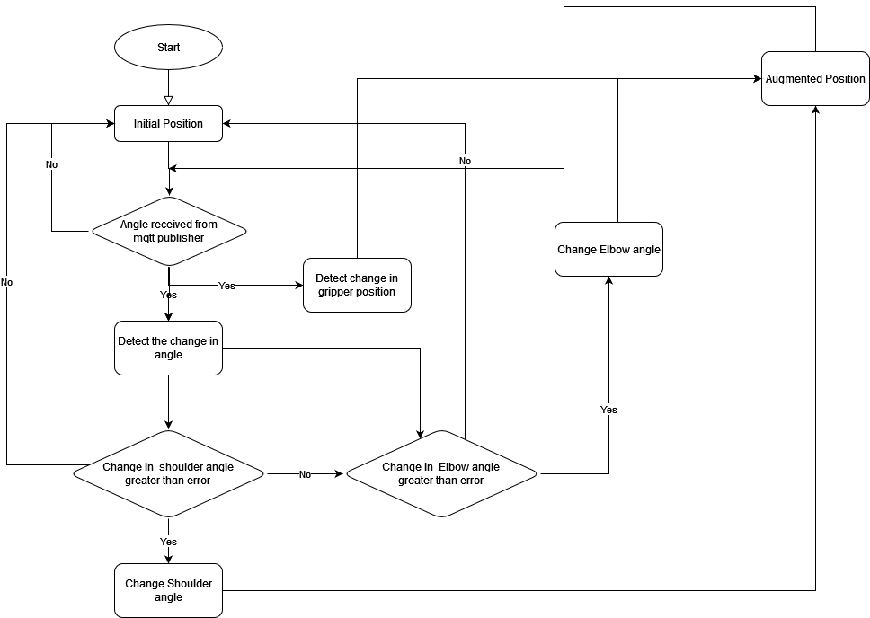
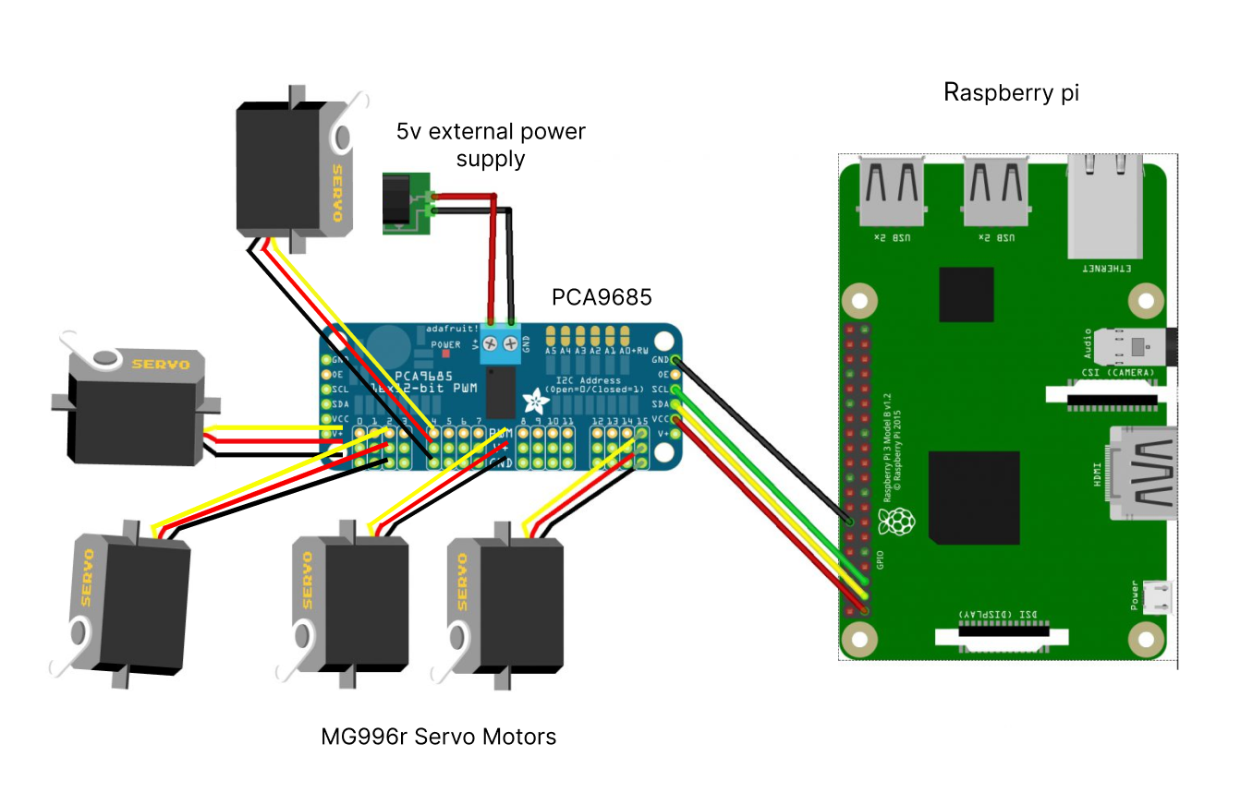
Previous Iteration
Arm Prototype:
Circuit diagram of the raspberry pi
Flow Chart of the Robotic Arm

Slide 10
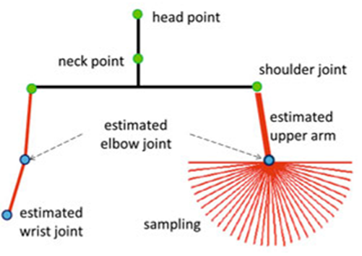
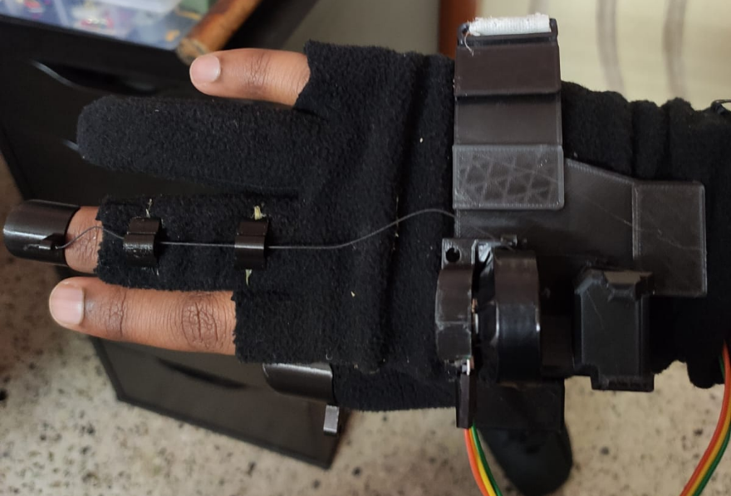
Previous Iteration
Pose Detection:
Mediapipe is a ML framework that does not require any model to be trained for achieving pose detection making it very easy to use
Landmarks are individual points around the human body that determines the location and what that part of the body is. For eg: Nose, Shoulder, Arm, etc.,
A physical contraption with spring loaded potentiometers is used to measure the finger motion on the hand.

Slide 11
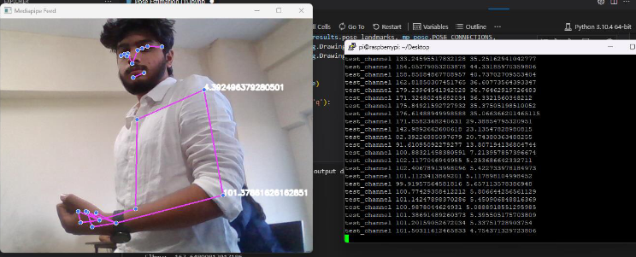
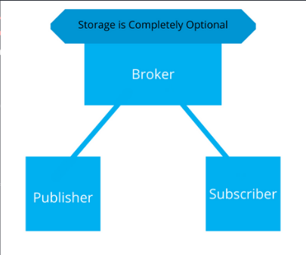
Previous Iteration
Networking:
Message Queuing Telemetry Transport or MQTT is a lightweight messaging protocol used to establish communication between IoT device
MQTT has 3 simple elements:
Publisher: One who sends the data (PC will act as Publisher
Broker: One who transmits data from Publisher to Subscriber
Subscriber: One who receives the data

Slide 12
Proposed Solution
This project aims to eliminate the complexity of Logical AI models, reduce the time complexity of Machine learning models, and eliminate the need for physical controllers to increase accuracy in movements.
It will make use of the several hardware and software components in order to achieve this.

Slide 13
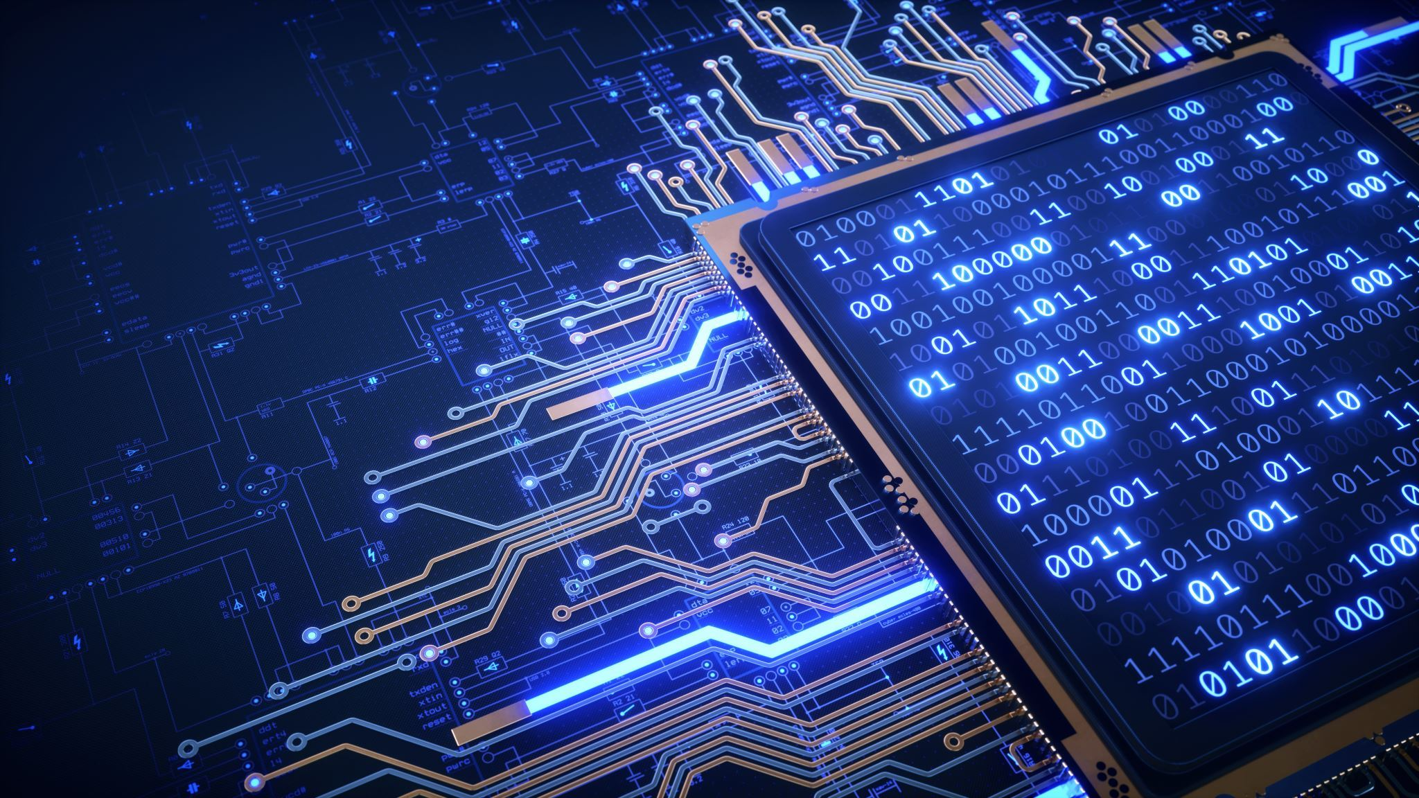
Requirements-Hardware
Raspberry Pi 3 or 4
Sensors
Motors
Camera Module
Computers
ESP32
PCA9685
End Effectors

Slide 14
Requirements-Software
Windows 10 64-bit OS
Python3
IDE
OpenCV
Mediapipe Modules
Eclipse Paho
ZeroTier
RPi Camera Web Interface

Slide 15
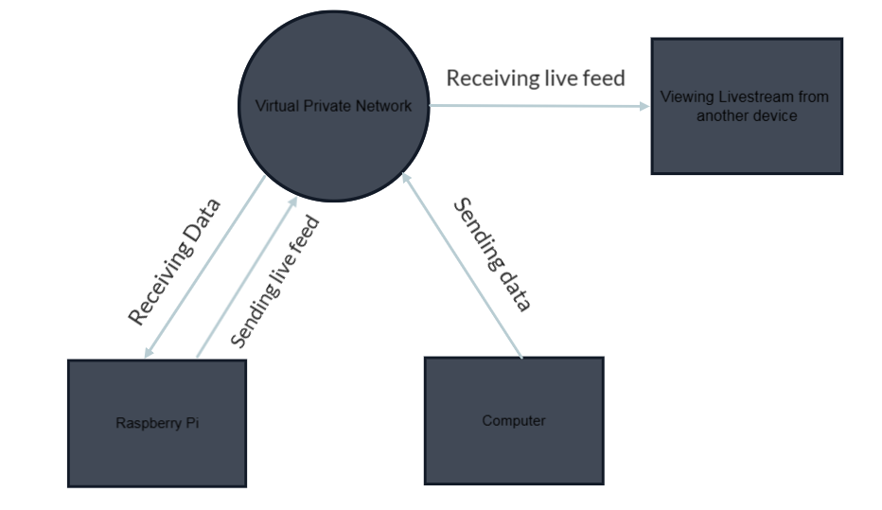
System Architecture

Slide 16
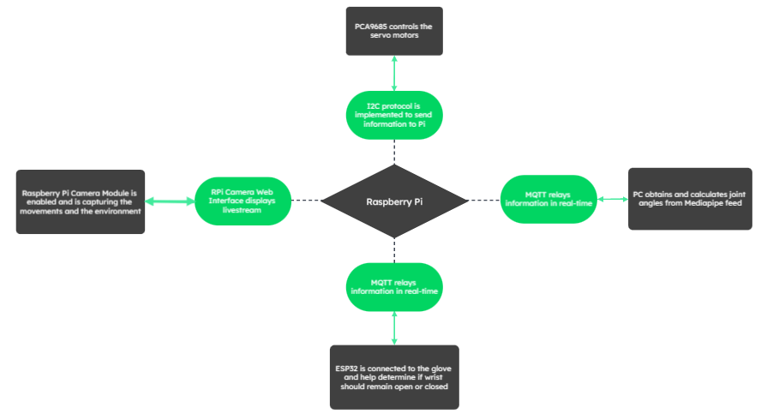
System Architecture-Pi

Slide 17
System Architecture
Prototype Robot Design:

Slide 19
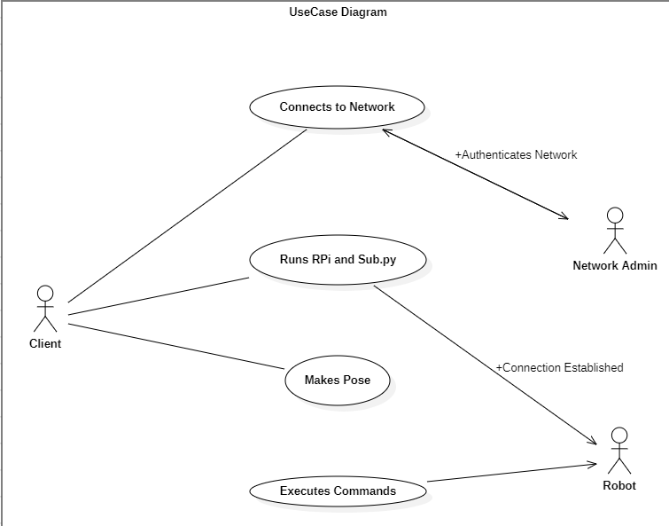
Modelling
UseCase Diagram:

Slide 20
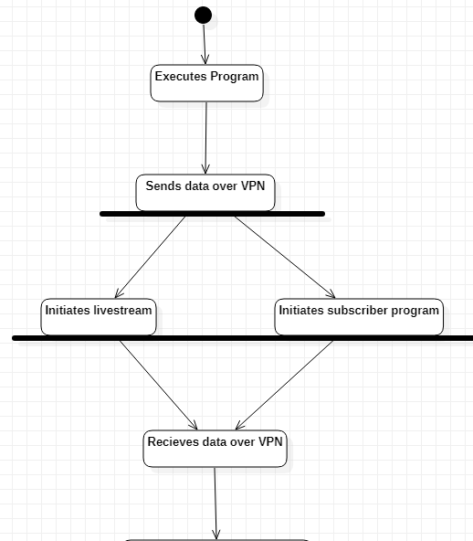
Modelling
Activity Diagram:

Slide 21
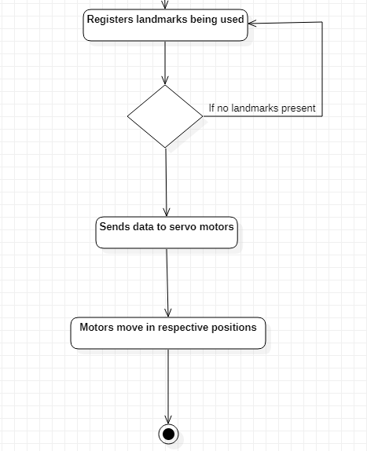
Modelling
Activity Diagram:

Slide 22
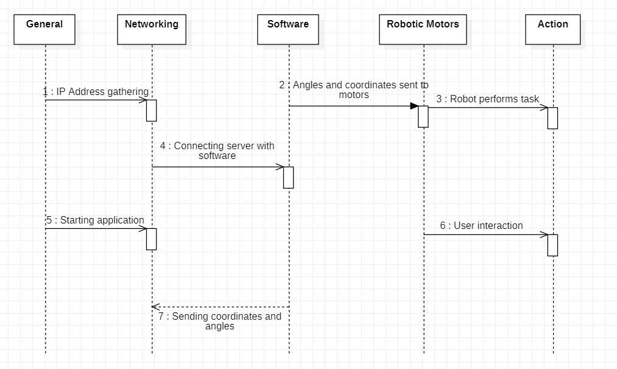
Modelling
Sequence Diagram

Slide 23
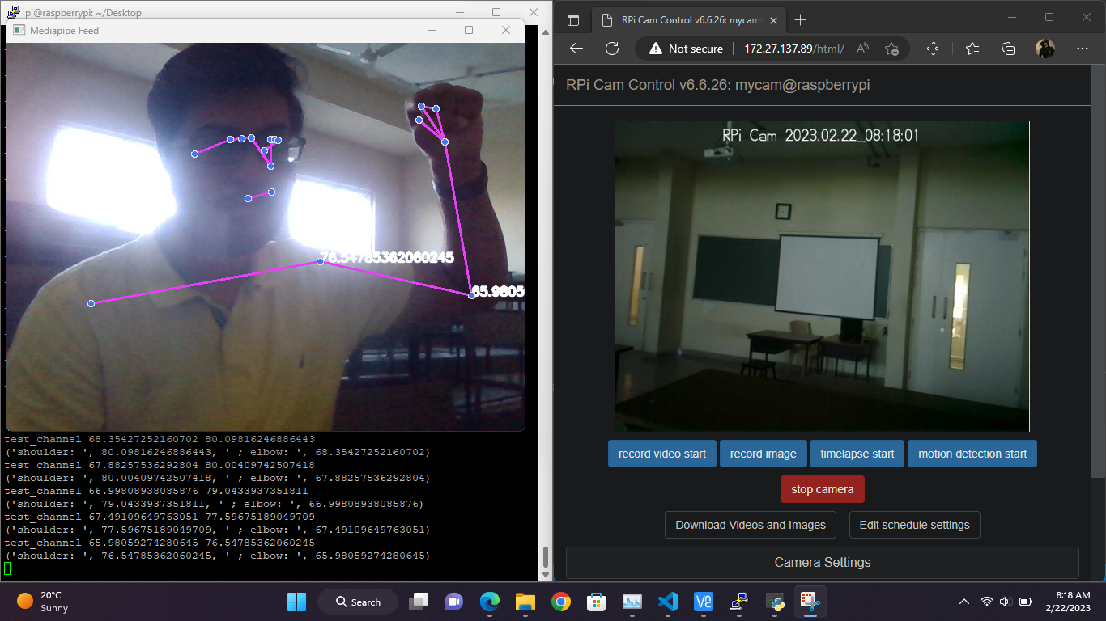
Current Outputs
The Window on the right represents what the Robot will see in real time in 480p 24 FPS. The framerate can be increased up to 1080p 60 FPS but high availability of bandwidth as well as a stable and adequate power supply will be needed.
The window on the left has two applications, PuTTy and Mediapipe Feed. PuTTy shows the data being received from the pc.

Slide 24
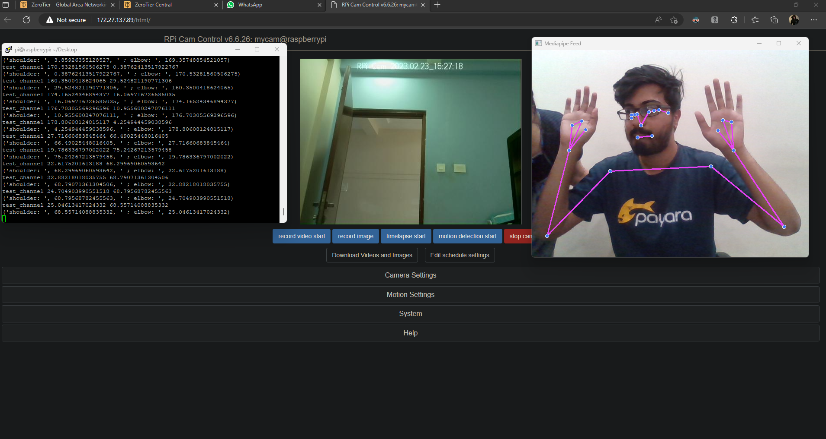
Current Outputs

Slide 25
Conclusion
Robotics is the future of humanity. The everyday objects we use are manufactured by using robotics in one way or another. Robotics would eventually be integrated into human life and body to either augment or enhance the performance of the body. The most difficult component next to designing the mechanics of the robotic device is finding an easy framework or interface to interact and control the device. This project aims to provide one possible solution to such a problem and to establish a groundwork to build an improved system in the future iterations.

